Slide 1
Heart
Disease

Slide 2
Outline
1- Introduction
2- Problem statement and objectives
3- Dataset description
4- Result
5- Discussion
6- Conclusion
7- References

Slide 3
Introduction
Objective: Evaluate the use of advanced data science techniques in the field of medicine and bioinformatics, specifically focusing on heart disease prediction.
Dataset Overview: 303 records, 14 features, with the "goal" field indicating the presence of heart disease (values 0 to 4).

Slide 4
Problem statement and objectives
Problem statement
objectives
The dataset is 13 selected features, where the objective is to use predictive statistics and data mining techniques, to predict the presence of heart diseases, and the severity, however in this project we are only interested in the presence of heart diseases.
"To leverage predictive statistics and data mining techniques on a dataset comprising 13 selected features with the primary aim of forecasting the presence of heart diseases. In this project, the specific focus is on identifying and predicting the occurrence of heart diseases, rather than assessing their severity. The objective is to employ advanced data science methodologies to enhance the accuracy and efficiency of predicting the presence of heart diseases, contributing to early detection and intervention in the medical domain."

Slide 5
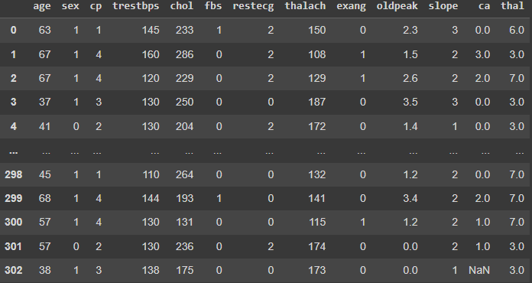
Dataset description
Heart disease
The dataset has 303 record with 13 columns The details of each column is given below

Slide 6
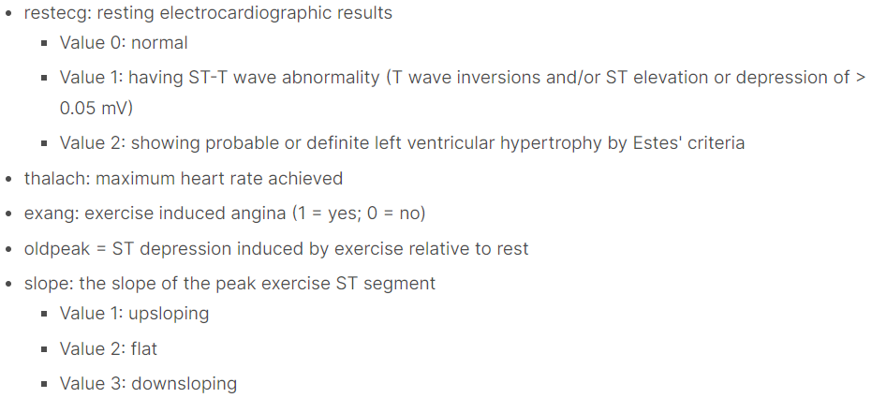
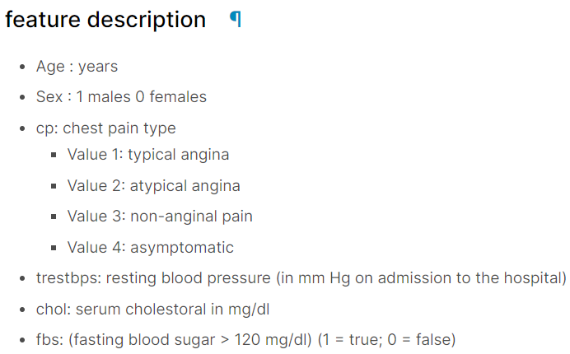
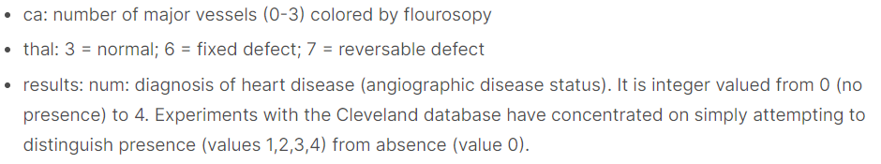
Dataset description
Heart disease

Slide 7
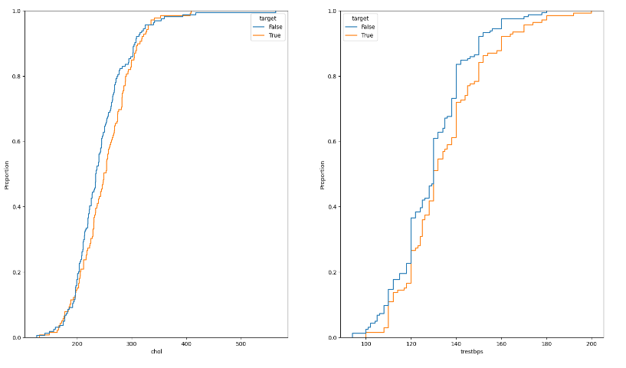
Data Analysis
First we looked at the variables we have 13 variables, our strategy is to analyze continuous variables, and discover the relationship between it and other categorical and discrete variables, with a focus on the target variable.

Slide 8
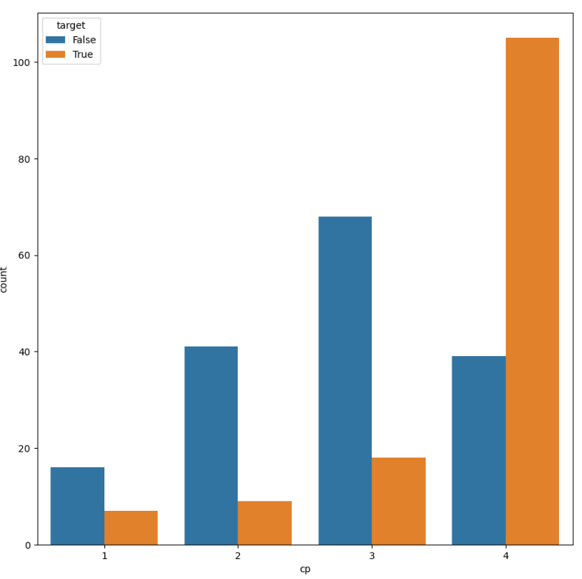
Subplots
Asymptomatic chest discomfort is strongly predictive of heart disease patients, as illustrated in figure 4, and may serve as a useful marker for the condition.

Slide 9
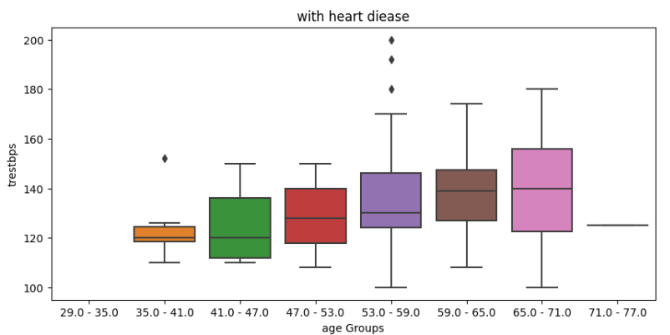
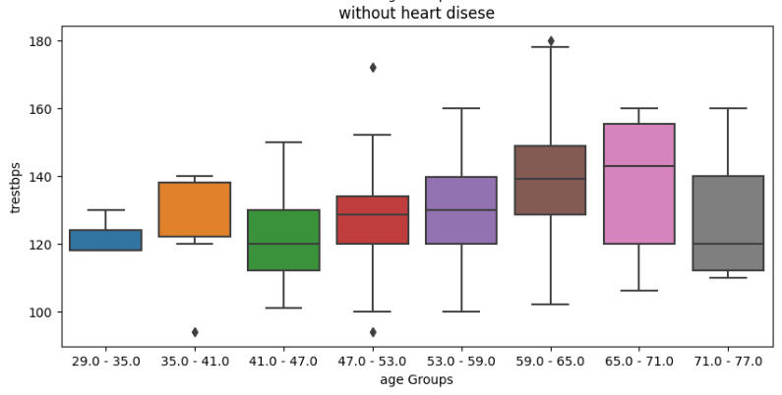
Boxplot
Figure 3 demonstrates that heart disease is only common in patients over the age of 35. It also shows that there is a greater number of cases where the resting blood pressure is significantly higher than the dataset median, and the median appears to have a positive trend for cases with heart disease diagnosis. On the other hand, there is no discernible pattern for cases without heart disease.

Slide 10
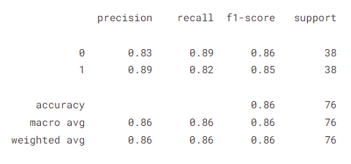
SVM
SVM scored an accuracy of 86%
and we got best accuracy

Slide 11
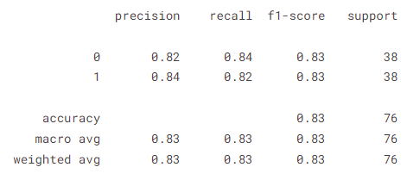
XGBOOST
Features must be scaled in order for the XGBOOST.
More data is needed in order to optimize the model performance.

Slide 12
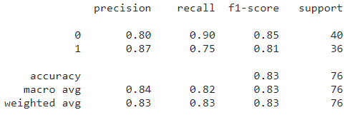
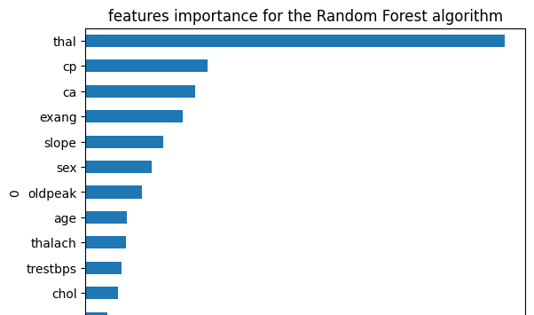
random forest
Still haven’t improved the recall of the –ve class.
There are a sign of overfitting, since the model biased giving more weights for the thalassemia features.

Slide 13
conclusion
In this project we have analyzed the relationship between heart disease and clinical features for 303 participants, the aim was to be able to successfully predict the outcome, and to explain how these features, relate to the presence of heart disease.
While we were able to successfully explain the results, more data is needed to improve the performance and the predictive power of the model.
Also the use of artificial neural network has proved to yield higher accuracy in predicting the outcome, however we can’t explain the results.

Slide 14
References
[1] R. C. Detrano et al., “International application of a new probability algorithm for the diagnosis of coronary artery disease.,” Am J Cardiol, vol. 64 5, pp. 304–10, 1989, [Online]. Available: https://api.semanticscholar.org/CorpusID:23545303
[2] A. B. Nassif, O. Mahdi, Q. Nasir, M. A. Talib, and M. Azzeh, “Machine Learning Classifications of Coronary Artery Disease.”
[3] C. V. Subbulakshmi and S. N. Deepa, “Medical dataset classification: A machine learning paradigm integrating particle swarm optimization with extreme learning machine classifier,” Scientific World Journal, vol. 2015, 2015, doi: 10.1155/2015/418060.

Slide 15
Thank you

